Slide 1
Network Monitor
By
Sumanth Gunda
Goutham Donthu
Rajesh Jonnalagadda
Raviteja Yakkala

Slide 2
Introduction
In the office environment we experience many networking tools
Our project motto is to monitor all these tools at one place
Main portions of these tools include
Elements
Key Performance Indicators
Schedule

Slide 3
Module 1 - Elements
The activities in this module include
We can add elements to the tool
New elements can be added to the tool. One has to select element name, Display name and the tool name
We can update elements
If we select update we can change element name and element display name
We can disable elements
If we select disable option, element gets disabled and active state changes from 1 to 0

Slide 4
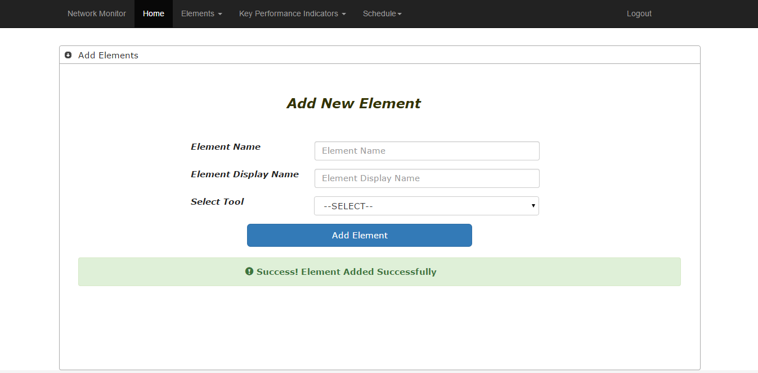
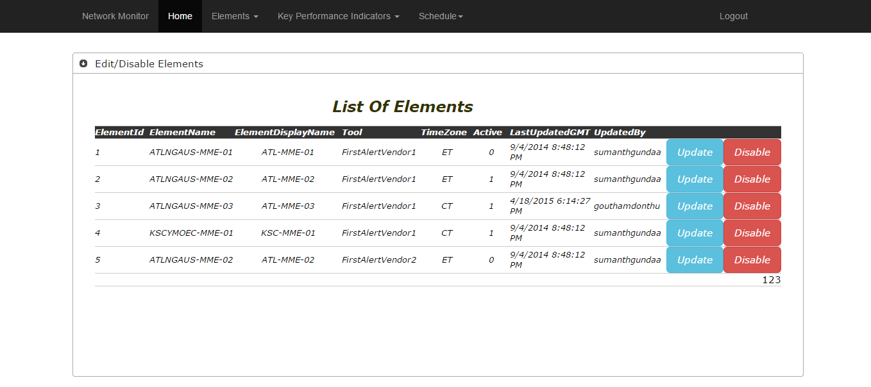

Slide 5
Module 2 – Key Performance Indicators
The activities in this module include
We can add KPI
We have to enter all the details of the KPI and if we select add KPI then KPI will be added to the tool
We can update KPI
If we select update KPI we can change all the details except KPI ID and Schedule ID since they are primary keys
We can disable KPI
If we select disable option, KPI gets disabled and active state changes from 1 to 0

Slide 6
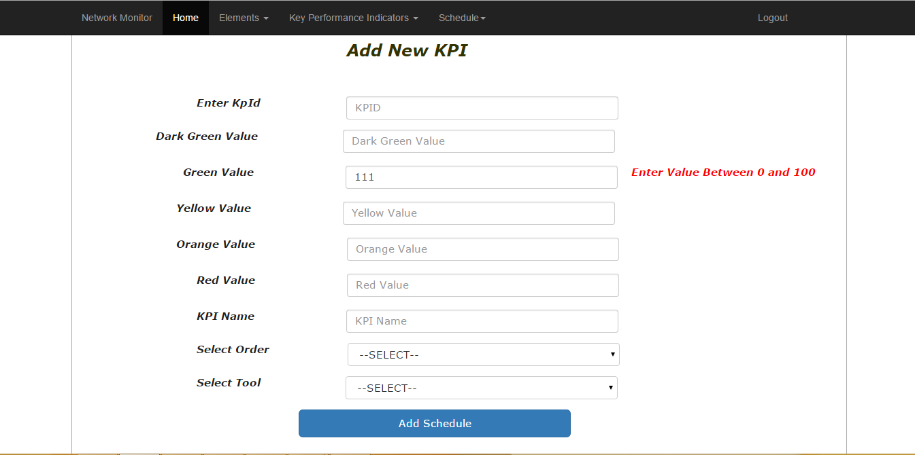
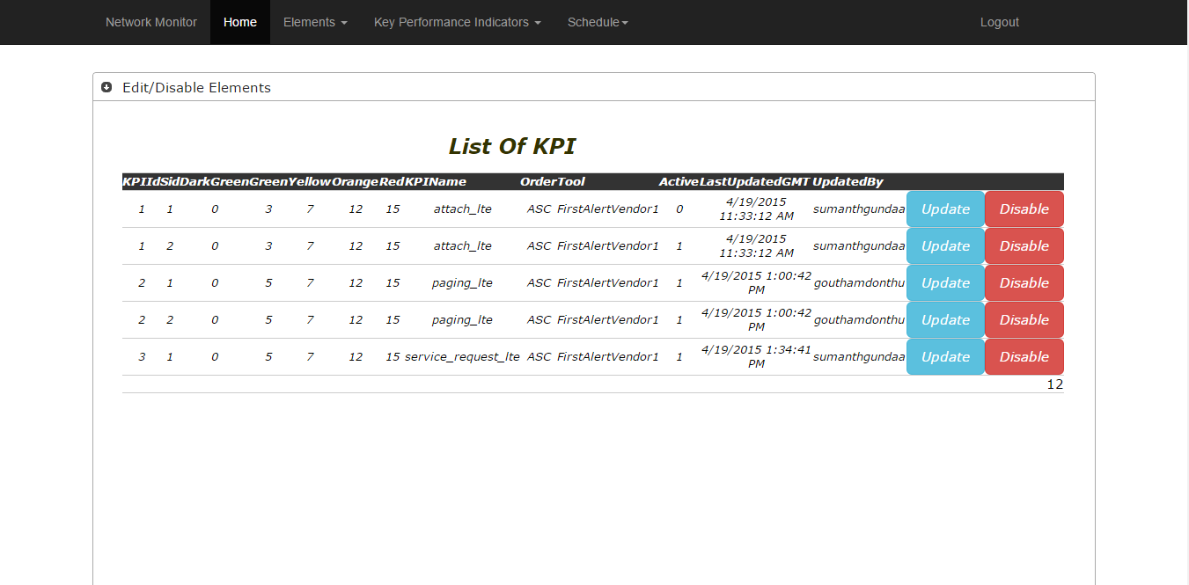

Slide 7
Module 3 - Schedule
We can add a schedule
We have to enter Schedule name, Starting and Ending hours to add a schedule. If we choose a start time and end time that is being scheduled already you are not allowed to add that schedule
We can update a schedule
If we select update option, we can change schedule name, start and end hours
We can disable a schedule
If we select disable option, schedule gets disabled and active state changes from 1 to 0

Slide 8
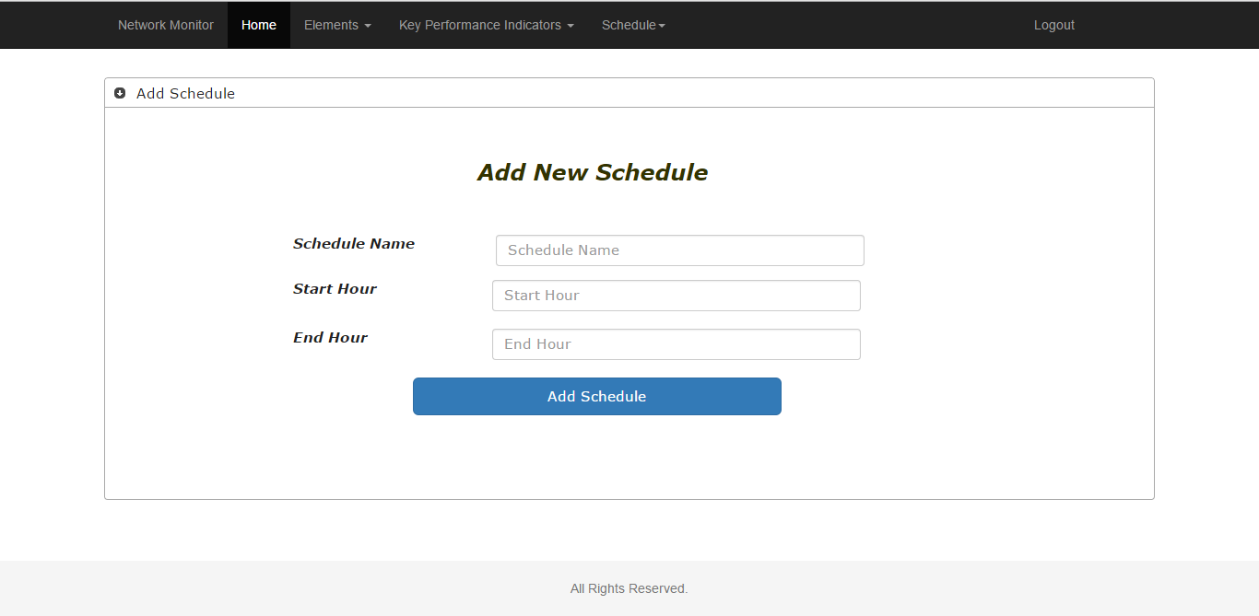
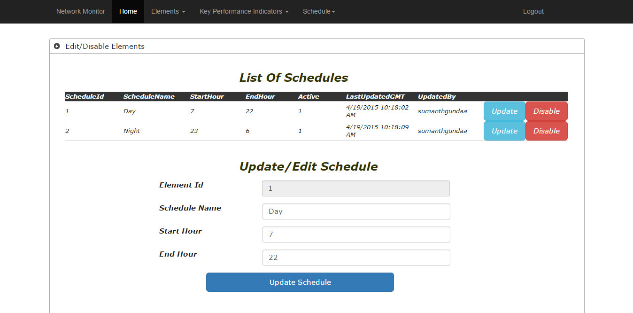

Slide 9
Languages and Tools used
Front end Languages
C#, ASP .Net, HTML, CSS, Jquery
Back end Languages
SQL Server 2008
Front end Tools
VisualStudio 2012
Back end Tools
Microsoft SQL Server 2008 R2

Slide 10
Youtube URL
https://www.youtube.com/watch?v=HxaX50Dqqdw
Github Link
https://github.com/sumanthgundaa/HackathonProject

Slide 11


